Slide 1
A Presentation On
Case Study : E-Commerce Website
(Myntra)
Presented by,
Chaudhari Darshan Rajendra

Slide 2
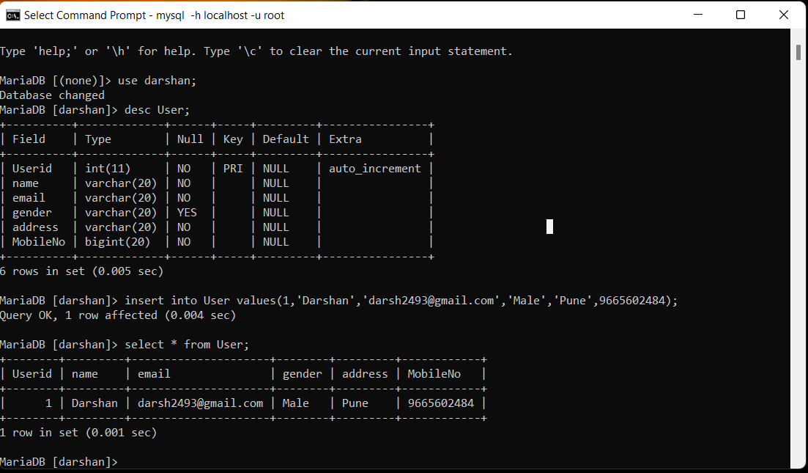
User Table :
SQL Query:
Create table User(Userid int primary key auto_increment,name varchar(20),email varchar(20) not null,email varchar(20),gender varchar(20),address varchar(20) not null,MobileNo bigint not null);
Inserting into User Table :
Insert into User values(1,’Darshan’,’darsh2493@gmail.com’,’Male’,’Pune’,9665602484);

Slide 3
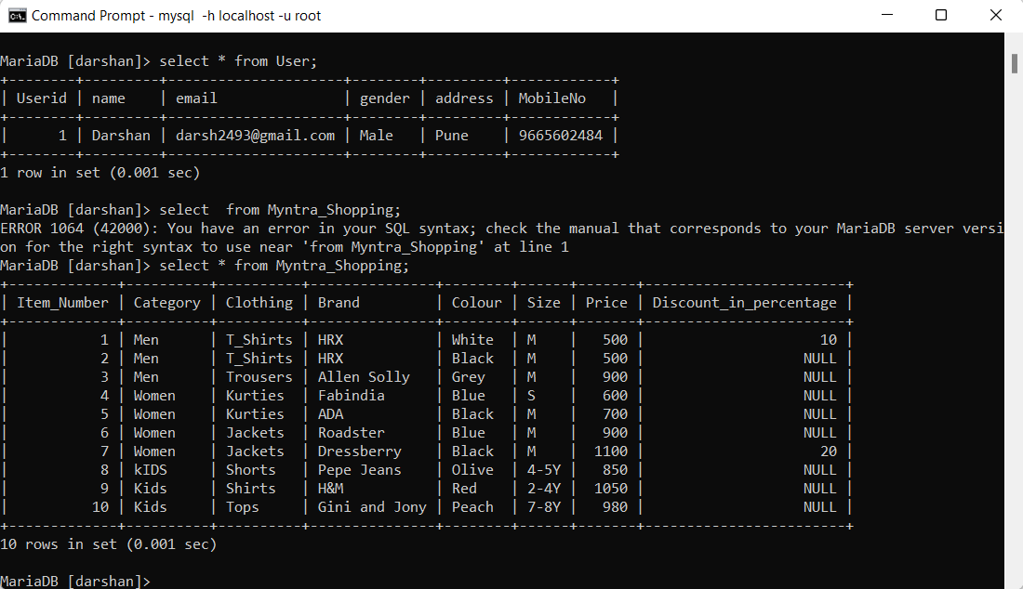
PRODUCT TABLE :
Creating Product table :
create table Myntra_Shopping(Item_Number int primary key auto_increment,Category varchar(20),Clothing varchar(20),Brand varchar(20),Colour varchar(20),Size varchar(20),Price int, Discount_in_percentage int);

Slide 4
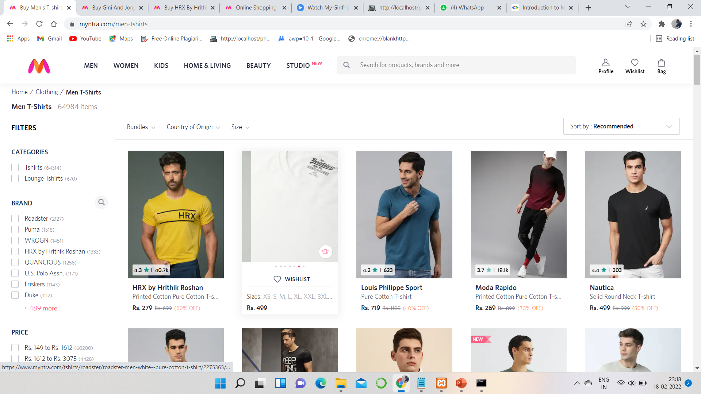
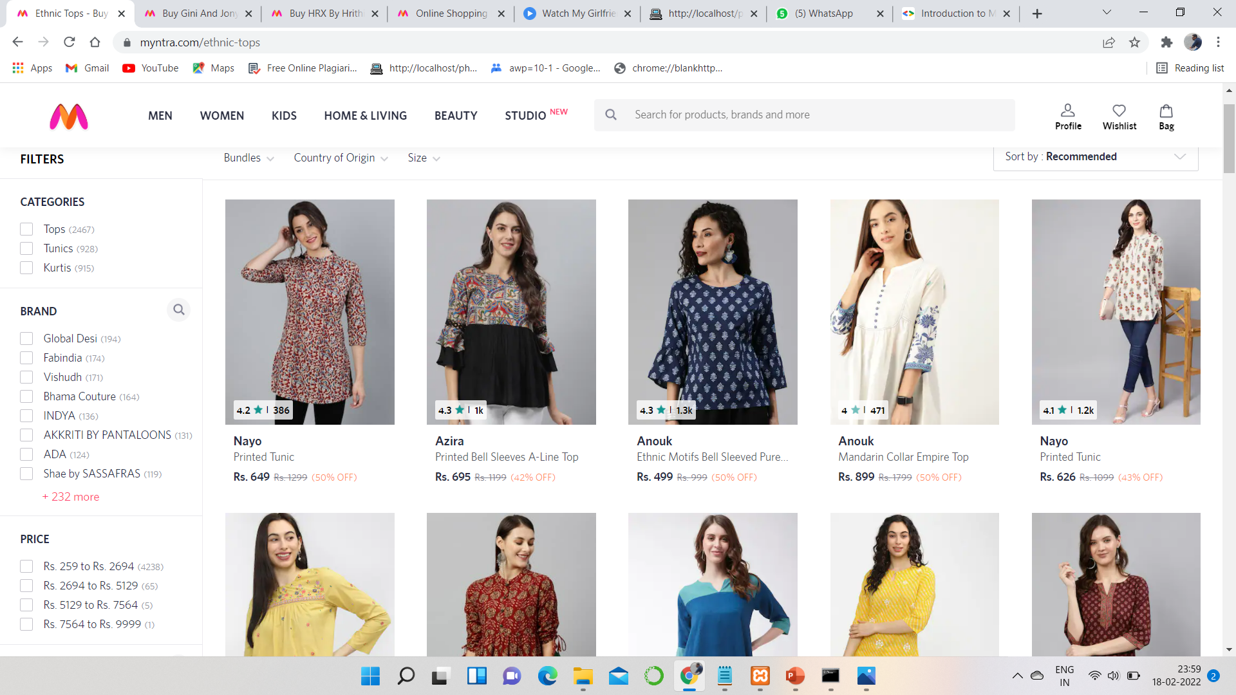
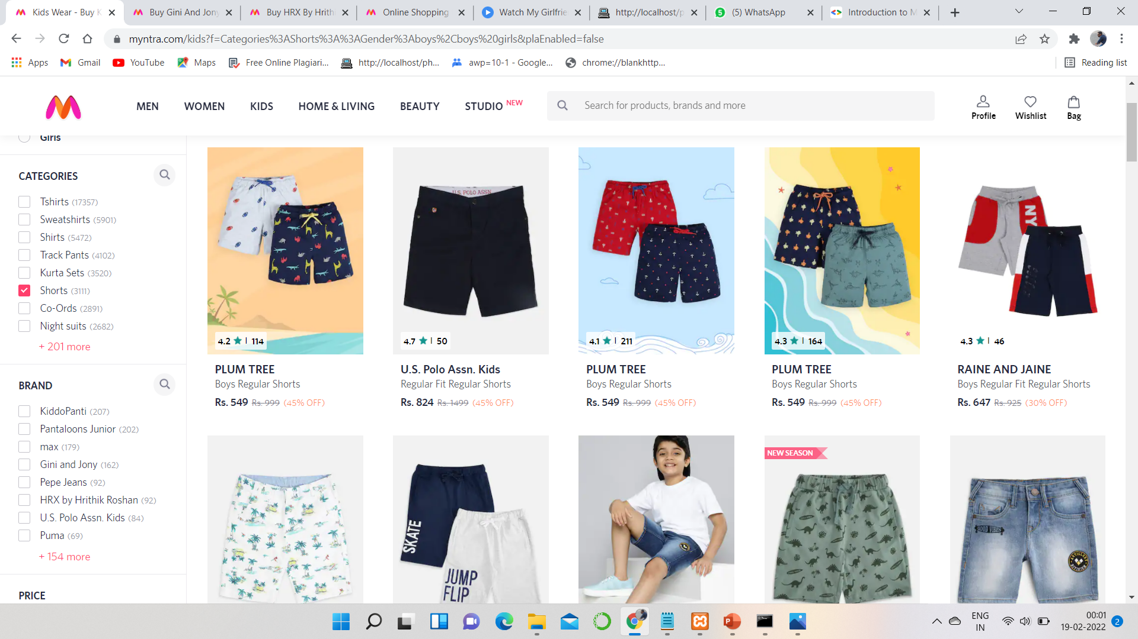
Products On Website :

Slide 5
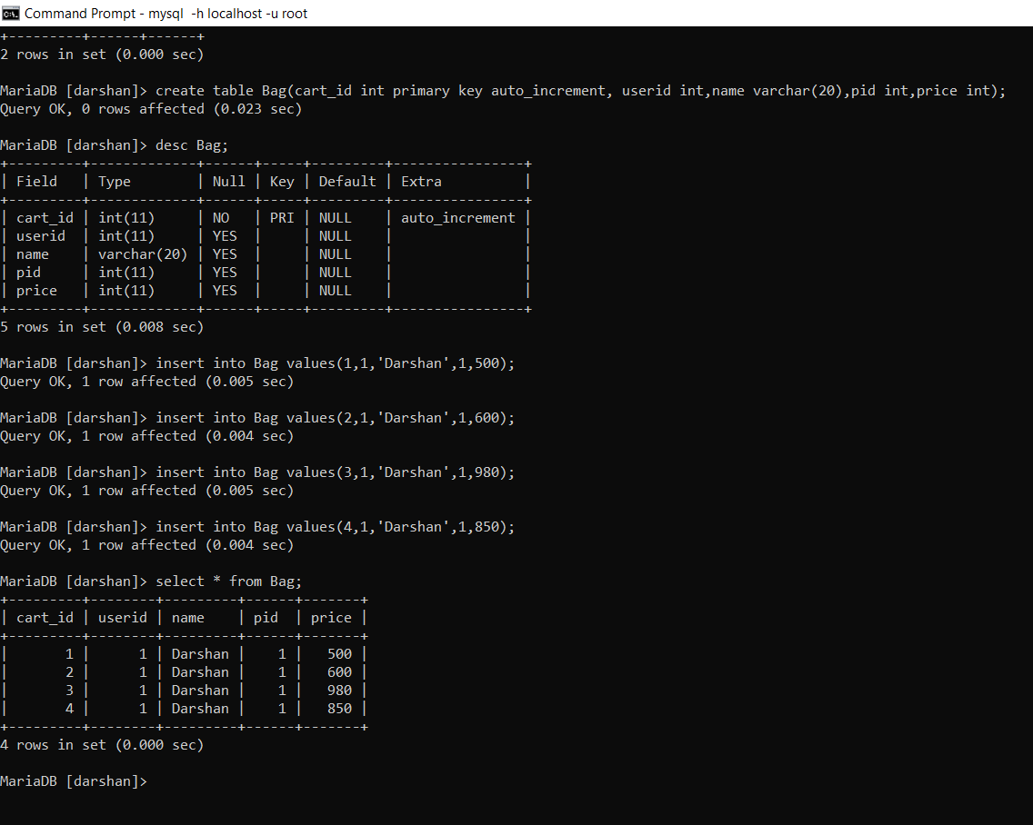
Bag Table :
Creating Bag Table :
Create table Bag(cart_id int primary key auto_increment, userid int,name varchar(20),pid int,price int);
Insert into Bag Table :
Insert into Bag values(1,1,’Darshan’,1,500),(2,1,’Darshan’,1,600),(3,1,’Darshan’,1,980),(4,1,’Darshan’,1,850);

Slide 6
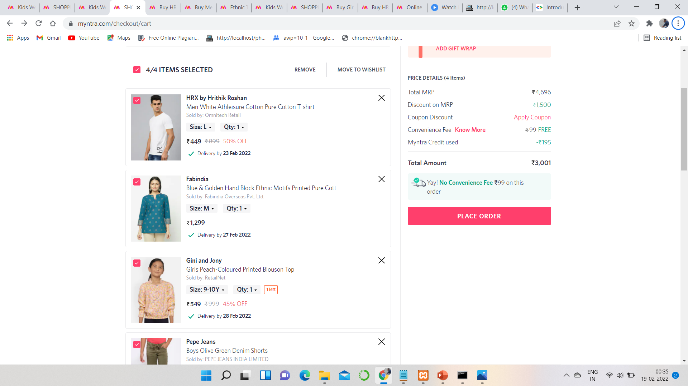
Bag Items : Add Products to Bag

Slide 7
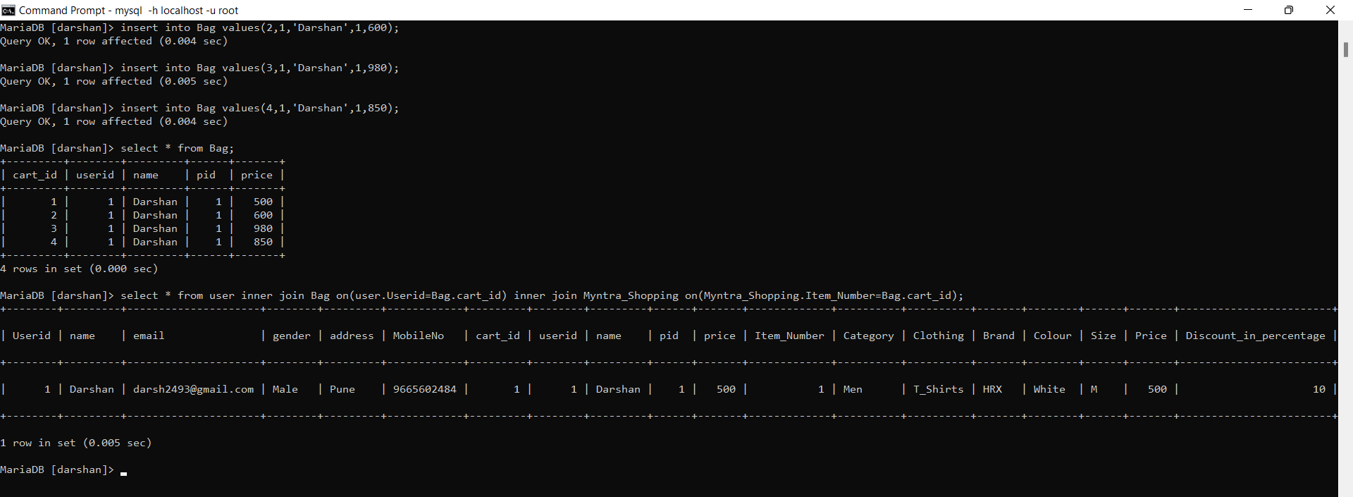
Join Table : User Table + Order Table + Bag Table
Inner Join :
select * from user inner join Bag on(user.Userid=Bag.cart_id) inner join Myntra_Shopping on(Myntra_Shopping.Item_Number=Bag.cart_id);

Slide 8
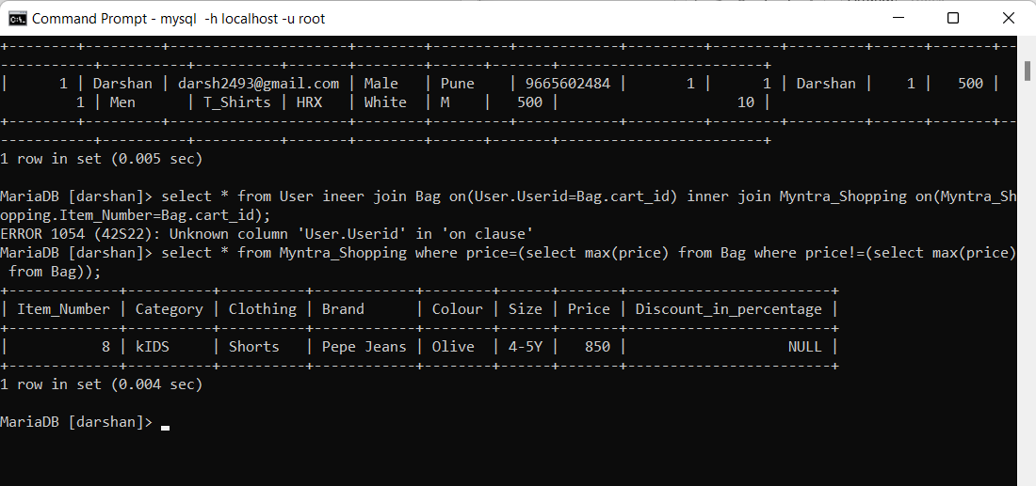
Search for Products :
For Searching Products according to max price :
select * from Myntra_Shopping where price=(select max(price) from Bag where price!=(select max(price) from Bag));

Slide 9
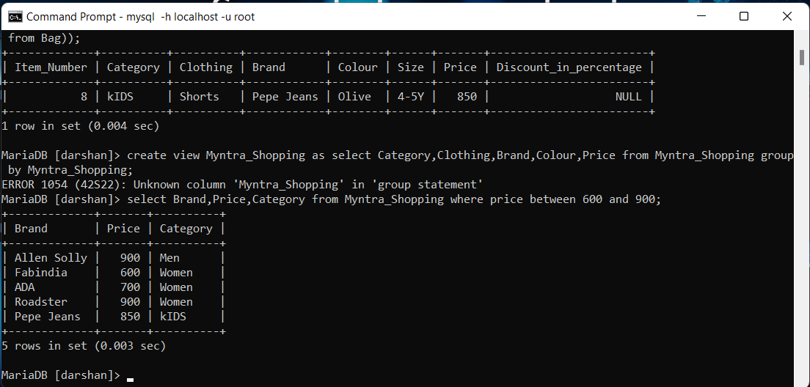
Searching particular products :
Selecting Brands between particular range :
select Brand,Price,Category from Myntra_Shopping where price between 600 and 900;

Slide 10
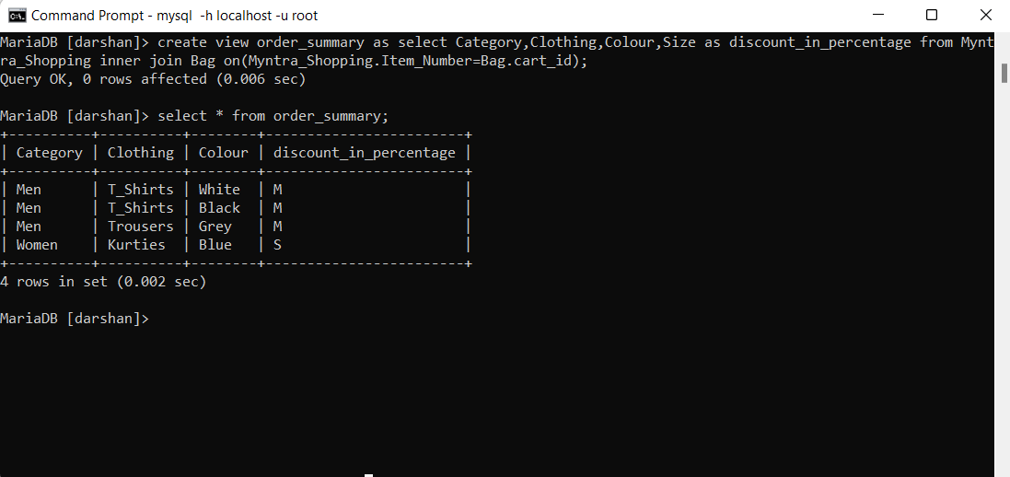
Creating View of Order Summary :
View of Order_summary :
create view order_summary as select Category,Clothing,Colour,Size as discount_in_percentage from Myntra_Shopping inner join Bag on(Myntra_Shopping.Item_Number=Bag.cart_id);

Slide 11
Thank You….

